Slide 1

Welcome to our presentation on Machine learning for a 5G future

Slide 2
Group members
1.Md.Abdullah(IT-17015)
2.Md.Shohag Hossain(IT-17060)

Slide 3
Outlines
What is machine learning?
Application of machine learning
What is 5G network?
Features of 5G network
Advantages of 5G network
why we need machine learning in 5G network?
Future of machine learning in 5G network

Slide 4
What is Machine learning?
Machine learning is the process of teaching a computer system how to make accurate predictions when fed data.
Machine learning is enabling computers to tackle tasks that have, until now, only been carried out by people.

Slide 5
Applications of machine learning system
Image Recognition
Speech Recognition
Medical diagnosis
Statistical Arbitrage
Learning associations
Classification
Prediction
Extraction
Regression
Financial Services

Slide 6
What is 5G network?
5G is the 5th generation of mobile networks, a significant evolution of todays 4G LTE networks.
5G has been designed to meet the very large growth in data and connectivity of today’s modern society, the internet of things with billions of connected devices, and tomorrow’s innovations.

Slide 7
Features of 5G network
It operates at higher frequencies
Introduces more complex antenna/cell configurations
Employs more sophisticated connectivity mechanisms like beamforming.
The multiple-input-multiple-output (MIMO) antennas used by 5G networks can handle multiple data “conversations” over the same data signal simultaneously.

Slide 8
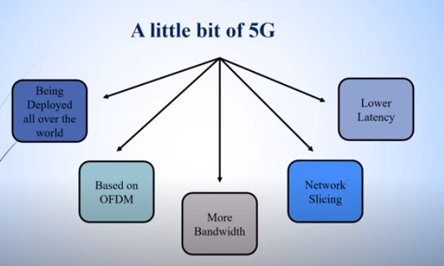

Slide 9
Advantages of 5G network
5G will enable instantaneous connectivity to billions of devices, the Internet of Things (IoT) and a truly connected world.
5G will provide the speed, low latency and connectivity to enable a new generation of applications.
For communities, 5G will enable the connection of billions of devices for our smart cities, smart schools and smart homes and etc

Slide 10
Why we need Machine learning in 5G?
Machine learning will be a necessary part of any 5G network since it’s more complicated than previous generation networks.
As more devices come on board a 5G network, it becomes impossible to handle all the traffic necessary without AI and machine learning.
A fully functional 5G network will not happen without Machine learning that can learn and make decisions by itself. These systems must be predictive and proactive on their own, so the data gets where it needs to be..

Slide 11
Future application of machine learning in 5G network
Network Optimization Opportunities
Boosting Performance and Cutting Costs
Optimizing network management
Security etc.

Slide 12
Network Optimization Opportunities
Machine learning offer several ways to boost network performance.
Machine learning can help optimize overall network management and monitoring.
Drive efficient resource consumption
And enable customized network layering (or slicing, as it’s known) to give owners more control over their network usage.

Slide 13
Boosting Performance and Cutting Costs
By analyzing the usage of the system, machine learning systems can determine and optimize device mobility patterns and quality of service usage to better predict network usage and congestion at specific locations throughout the day

Slide 14
Optimizing network management
Machine learning provides additional insights into the health of the network
by providing other capabilities and functionality for fault, performance, and security management.

Slide 15
Security
5G network should be smart enough to deal with increased bandwidth, higher spectrum utilization and high data rate.
ML techniques could help model these robust dynamic algorithms that can help to detect network issues and provide with the possible solution in real-time.
In the same way, ML protect the personal devices that are connected to the internet by providing adaptive security solutions that can tackle diverse network situations, threats, and attacks.

Slide 16
Security
Machine learning (ML) can play vital role in design, modelling and automation of efficient security protocols against diverse and wide range of threatsy.
Machine Learning can play central role in protecting highly data-driven softwareized and virtualized network components.

Slide 17
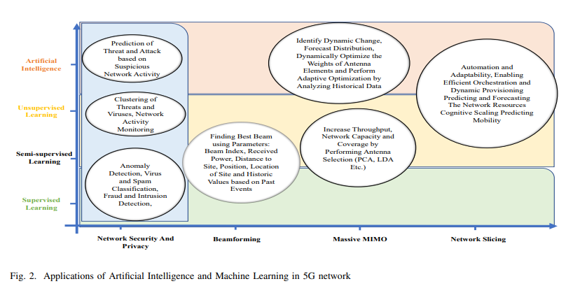

Slide 18
Thank you

